Slide 1
Frequent Item Mining

Slide 2
What is data mining?
=Pattern Mining?
What patterns?
Why are they useful?

Slide 3

Definition: Frequent Itemset
Itemset
  A collection of one or more items
    Example: {Milk, Bread, Diaper}
  k-itemset
    An itemset that contains k items
Support count (σ)
  Frequency of occurrence of an itemset
  E.g. σ({Milk, Bread,Diaper}) = 2
Support
  Fraction of transactions that contain an itemset
  E.g. s({Milk, Bread, Diaper}) = 2/5
Frequent Itemset
  An itemset whose support is greater than or equal to a minsup threshold

Slide 4
Frequent Itemsets Mining
TID | Transactions
100 | { A, B, E }
200 | { B, D }
300 | { A, B, E }
400 | { A, C }
500 | { B, C }
600 | { A, C }
700 | { A, B }
800 | { A, B, C, E }
900 | { A, B, C }
1000 | { A, C, E }
Minimum support level 50%
  {A},{B},{C},{A,B}, {A,C}
How to link this to Data Cube?

Slide 5
Three Different Views of FIM
Transactional Database
  How we do store a transactional database?
    Horizontal, Vertical, Transaction-Item Pair
Binary Matrix
Bipartite Graph
How does the FIM formulated in these different settings?

Slide 6

Frequent Itemset Generation
Given d items, there are 2^{d} possible candidate itemsets

Slide 7

Frequent Itemset Generation
Brute-force approach:
  Each itemset in the lattice is a candidate frequent itemset
  Count the support of each candidate by scanning the database
  Match each transaction against every candidate
  Complexity ~ O(NMw) => Expensive since M = 2^{d} !!!

Slide 8
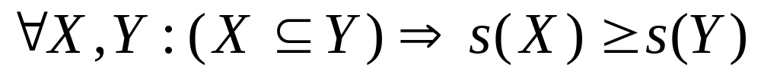
Reducing Number of Candidates
Apriori principle:
  If an itemset is frequent, then all of its subsets must also be frequent
Apriori principle holds due to the following property of the support measure:
  Support of an itemset never exceeds the support of its subsets
  This is known as the anti-monotone property of support

Slide 9


Illustrating Apriori Principle
Found to be Infrequent
Pruned supersets

Slide 10

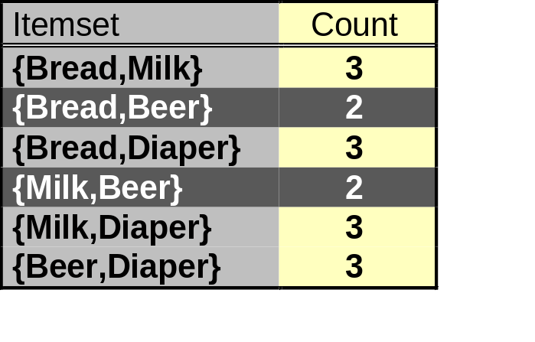
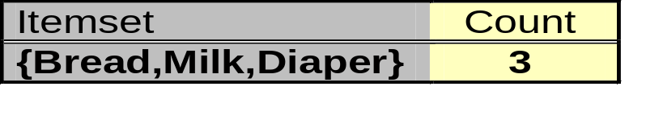
Illustrating Apriori Principle
Items (1-itemsets)
Pairs (2-itemsets)
(No need to generate
candidates involving Coke
or Eggs)
Minimum Support = 3
Triplets (3-itemsets)
If every subset is considered,
⁶C₁ + ⁶C₂ + ⁶C₃ = 41
With support-based pruning,
6 + 6 + 1 = 13

Slide 11
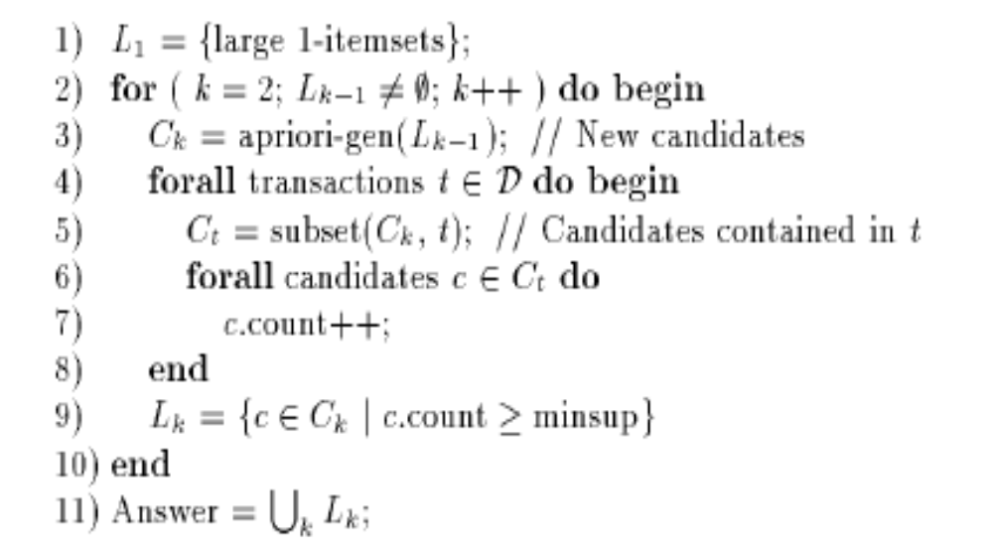
Apriori
R. Agrawal and R. Srikant. Fast algorithms for mining association rules. VLDB, 487-499, 1994

Slide 12
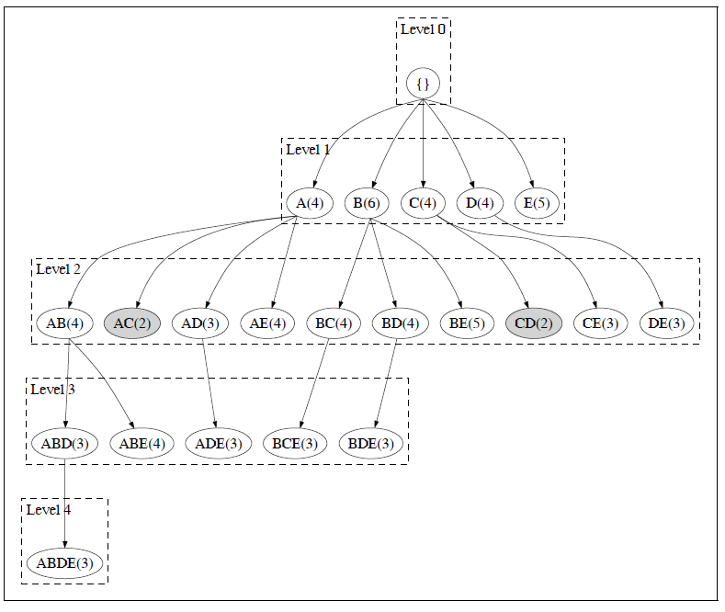

Slide 13
How to Generate Candidates?
Suppose the items in L_{k-1} are listed in an order
Step 1: self-joining L_{k-1}
  insert into C_{k}
  select p.item₁, p.item₂, …, p.item_{k-1}, q.item_{k-1}
  from L_{k-1} p, L_{k-1} q
  where p.item₁=q.item₁, …, p.item_{k-2}=q.item_{k-2}, p.item_{k-1} < q.item_{k-1}
Step 2: pruning
  forall itemsets c in C_{k} do
    forall (k-1)-subsets s of c do
      if (s is not in L_{k-1}) then delete c from C_{k}

Slide 14
Challenges of Frequent Itemset Mining
Challenges
  Multiple scans of transaction database
  Huge number of candidates
  Tedious workload of support counting for candidates
Improving Apriori: general ideas
  Reduce passes of transaction database scans
  Shrink number of candidates
  Facilitate support counting of candidates

Slide 15
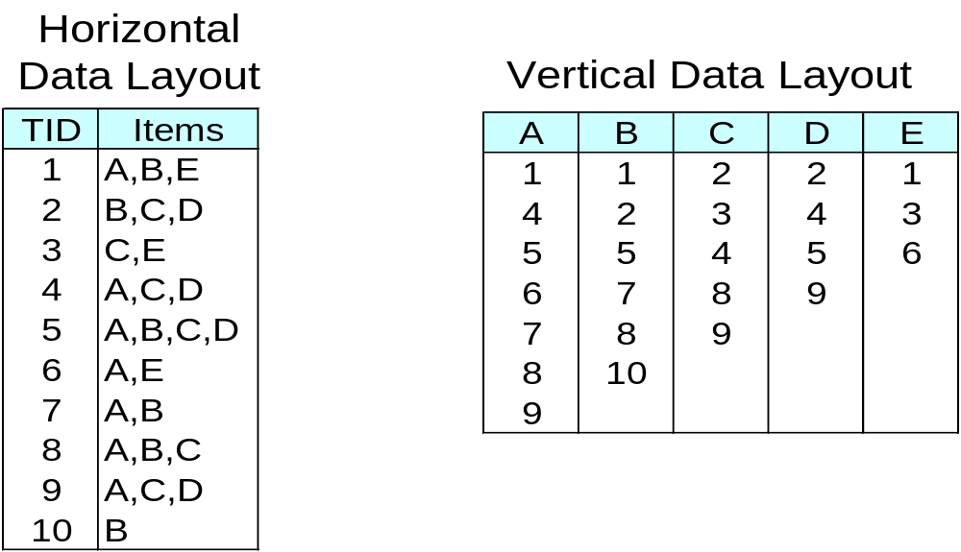
Alternative Methods for Frequent Itemset Generation
Representation of Database
  horizontal vs vertical data layout

Slide 16
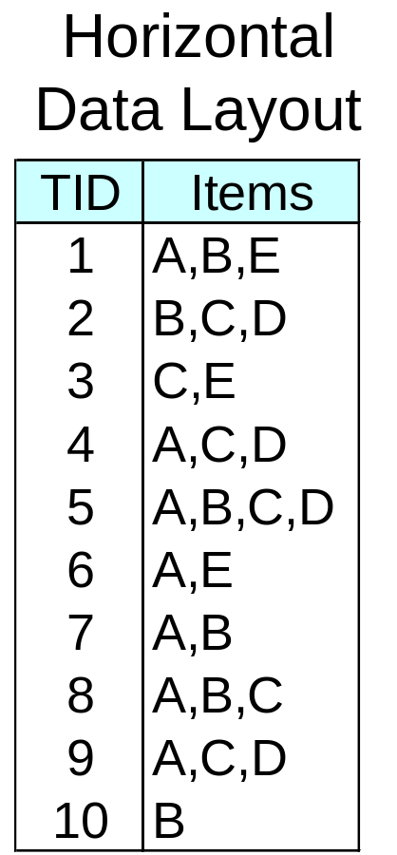
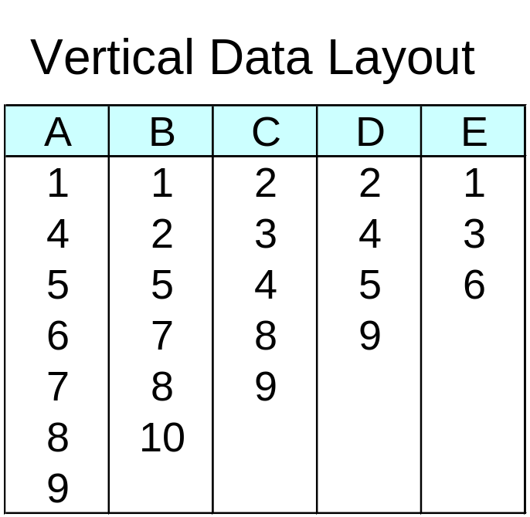
ECLAT
For each item, store a list of transaction ids (tids)
TID-list

Slide 17
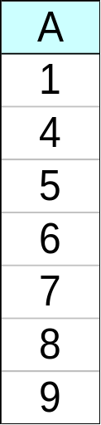
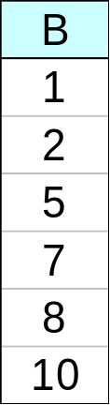
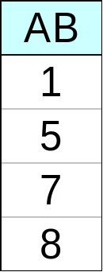
ECLAT
Determine support of any k-itemset by intersecting tid-lists of two of its (k-1) subsets.
3 traversal approaches:
  top-down, bottom-up and hybrid
Advantage: very fast support counting
Disadvantage: intermediate tid-lists may become too large for memory
∧
→

Slide 18
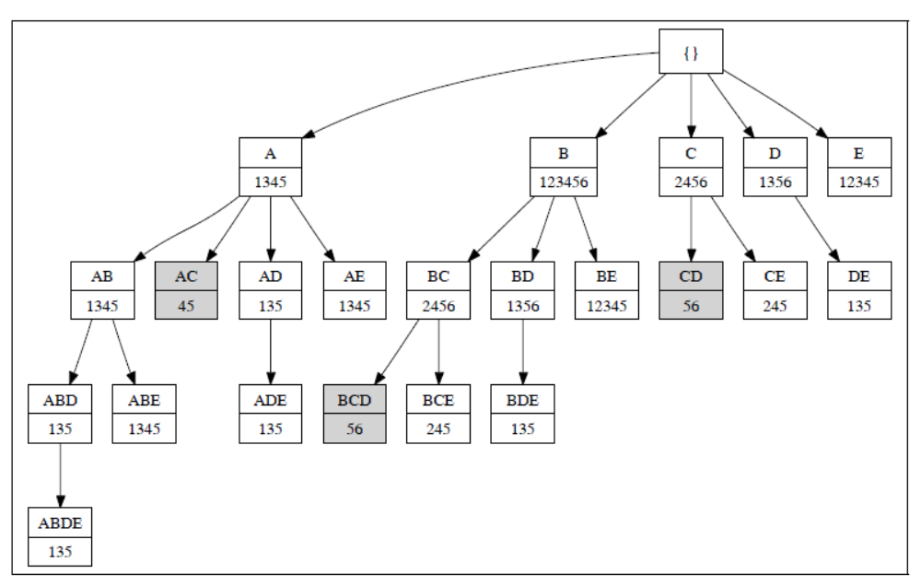

Slide 19
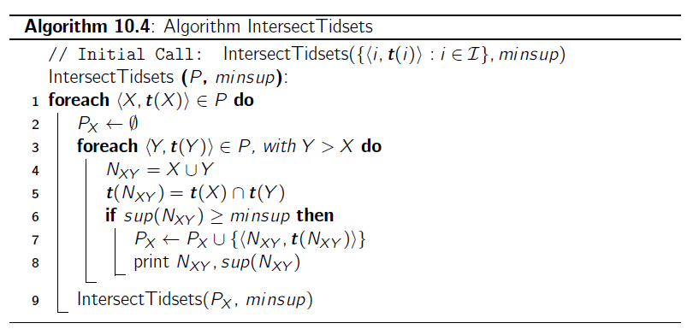

Slide 20
FP-growth Algorithm
Use a compressed representation of the database using an FP-tree
Once an FP-tree has been constructed, it uses a recursive divide-and-conquer approach to mine the frequent itemsets

Slide 21
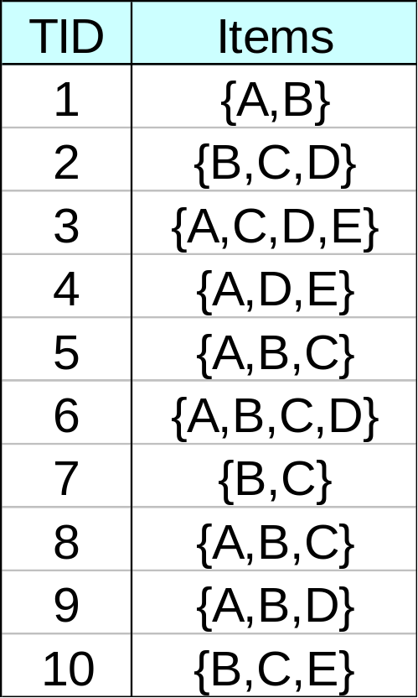
FP-tree construction
null
After reading TID=1:
A:1
B:1
After reading TID=2:
null
A:1
B:1
B:1
C:1
D:1

Slide 22
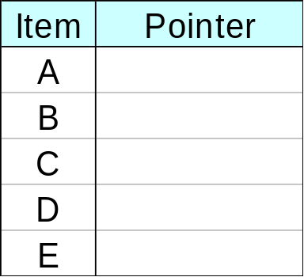
FP-Tree Construction
Transaction Database
null
A:7
B:3
B:5
C:3
C:1
D:1
Header table
D:1
C:3
E:1
D:1
E:1
D:1
E:1
D:1
Pointers are used to assist frequent itemset generation

Slide 23
FP-growth
null
Conditional Pattern base for D:
P = {(A:1,B:1,C:1),
(A:1,B:1),
(A:1,C:1),
(A:1),
(B:1,C:1)}
Recursively apply FP-growth on P
Frequent Itemsets found (with sup > 1):
AD, BD, CD, ACD, BCD
A:7
B:1
B:5
C:1
C:1
D:1
C:3
D:1
D:1
D:1
D:1

Slide 24
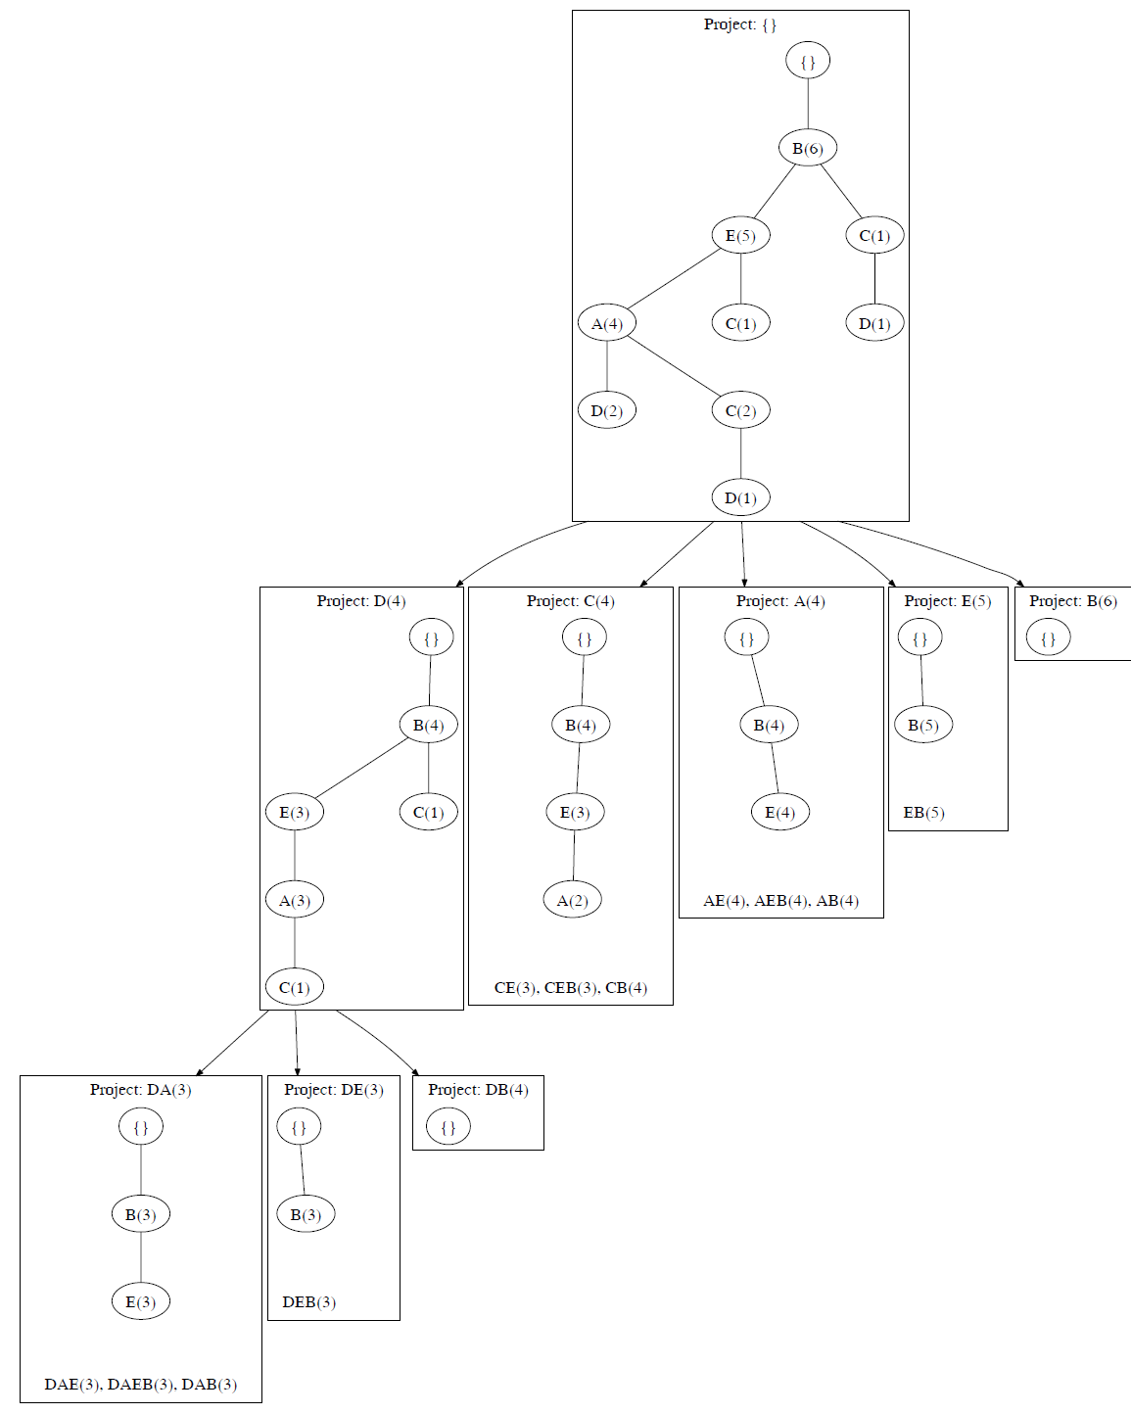

Slide 25
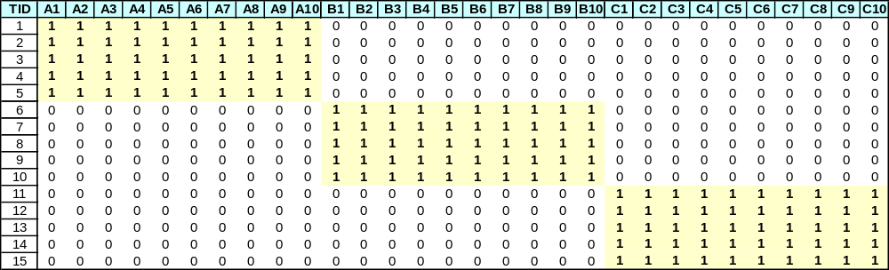
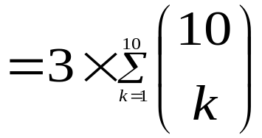
Compact Representation of Frequent Itemsets
Some itemsets are redundant because they have identical support as their supersets
Number of frequent itemsets
Need a compact representation

Slide 26
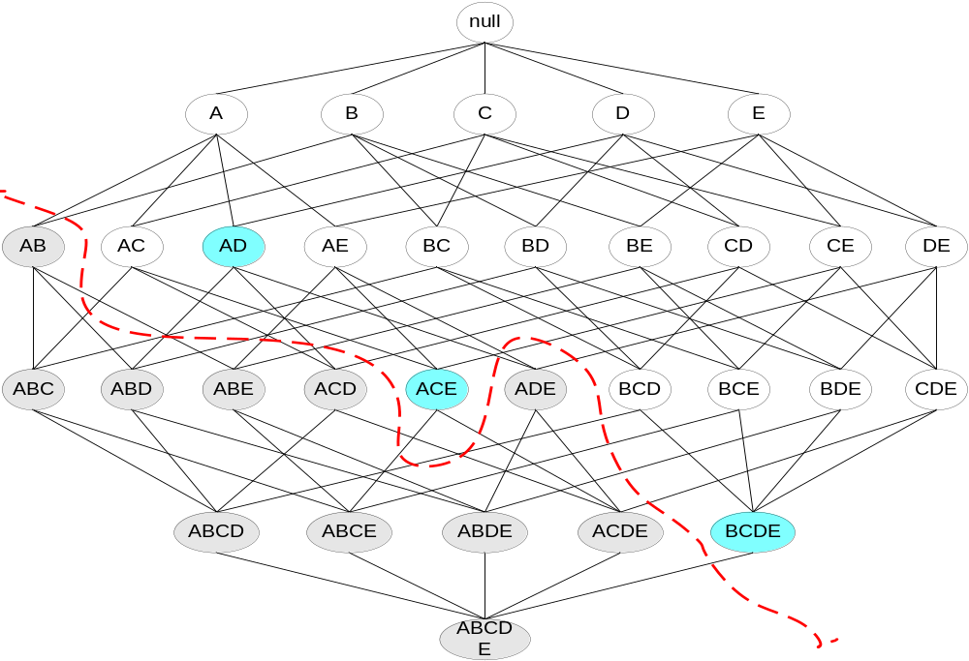
Maximal Frequent Itemset
An itemset is maximal frequent if none of its immediate supersets is frequent
Maximal Itemsets
Infrequent Itemsets
Border

Slide 27
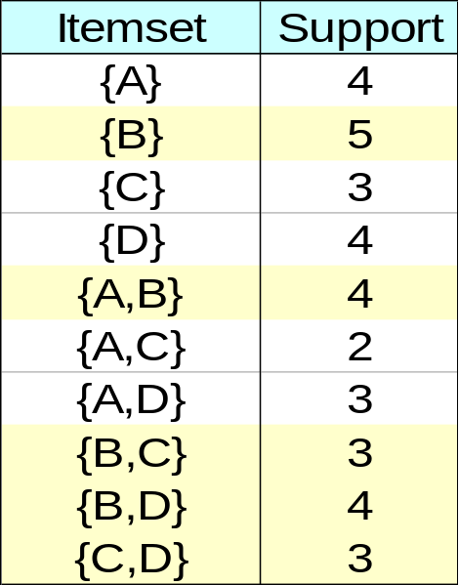
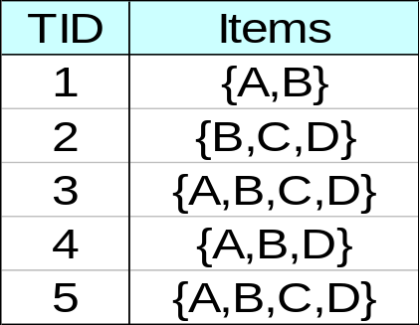
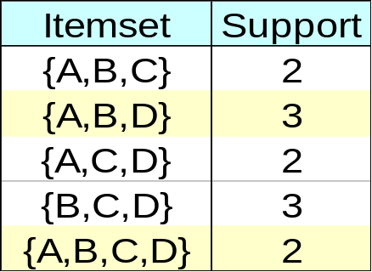
Closed Itemset
An itemset is closed if none of its immediate supersets has the same support as the itemset

Slide 28
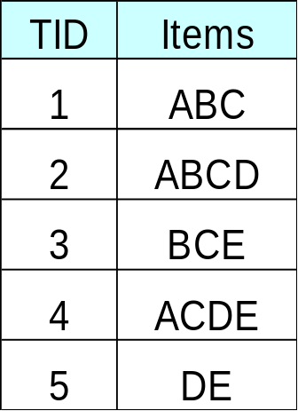
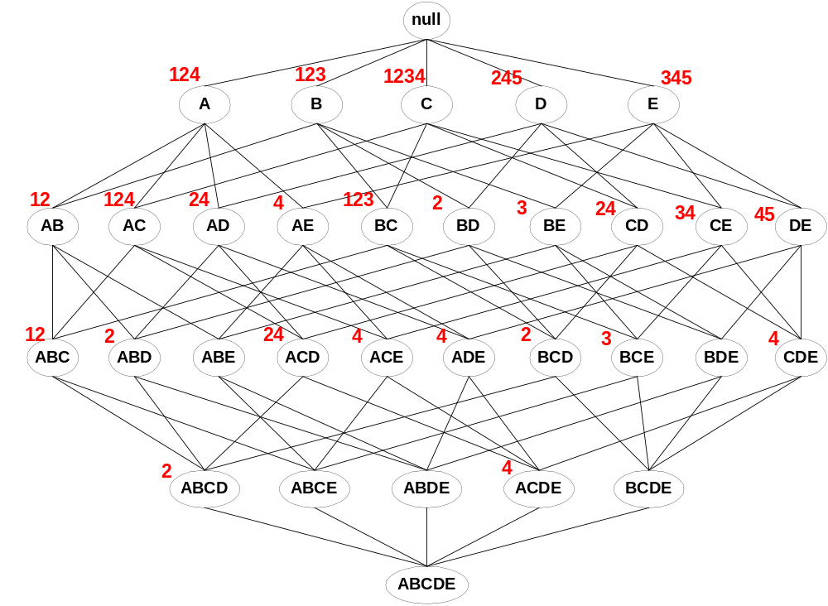
Maximal vs Closed Itemsets
Transaction Ids
Not supported by any transactions

Slide 29
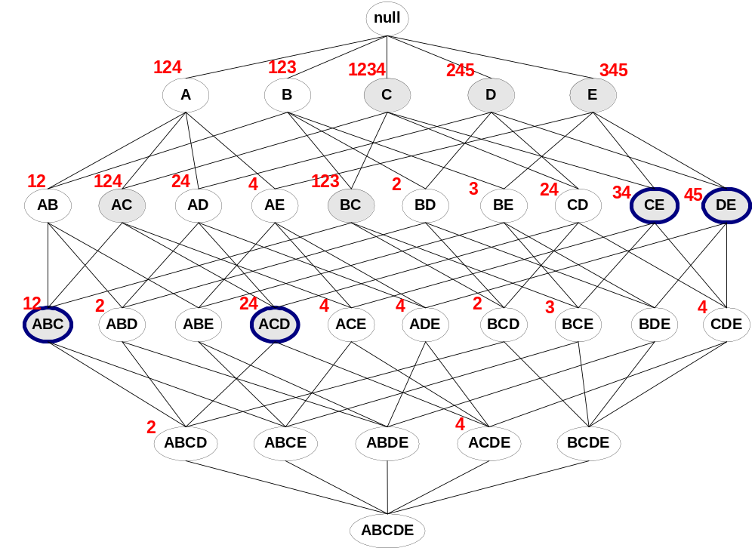
Maximal vs Closed Frequent Itemsets
Minimum support = 2
Closed but not maximal
Closed and maximal
# Closed = 9
# Maximal = 4

Slide 30
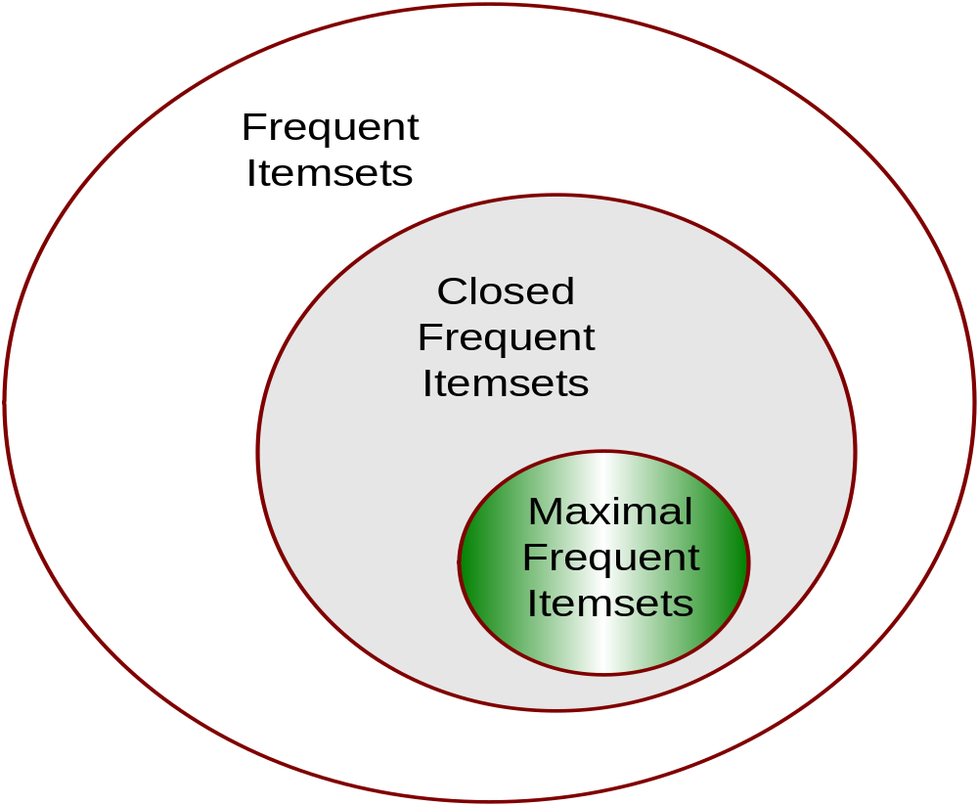
Maximal vs Closed Itemsets

Slide 31
Beyond Itemsets
Sequence Mining
  Finding frequent subsequences from a collection of sequences
Graph Mining
  Finding frequent (connected) subgraphs from a collection of graphs
Tree Mining
  Finding frequent (embedded) subtrees from a set of trees/graphs
Geometric Structure Mining
  Finding frequent substructures from 3-D or 2-D geometric graphs
Among others…

Slide 32
Frequent Pattern Mining
E
A
A
E
B
A
B
A
A
B
A
B
A
B
B
E
F
E
A
A
B
A
B
C
D
C
D
C
F
D
D
F
C
C
C
D
C
A
D
D
F
D
C
A
B
D
C

Slide 33
Why Frequent Pattern Mining is So Important?
Application Domains
  Business, biology, chemistry, WWW, computer/networing security, …
Summarizing the underlying datasets, providing key insights
Basic tools for other data mining tasks
  Assocation rule mining
  Classification
  Clustering
  Change Detection
  etc…

Slide 34
Network motifs: recurring patterns that occur significantly more than in randomized nets
Do motifs have specific roles in the network?
Many possible distinct subgraphs

Slide 35
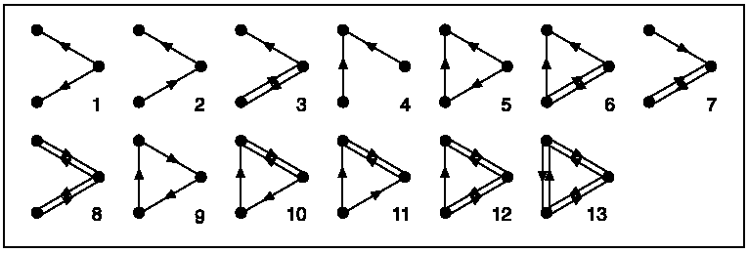
The 13 three-node connected subgraphs

Slide 36
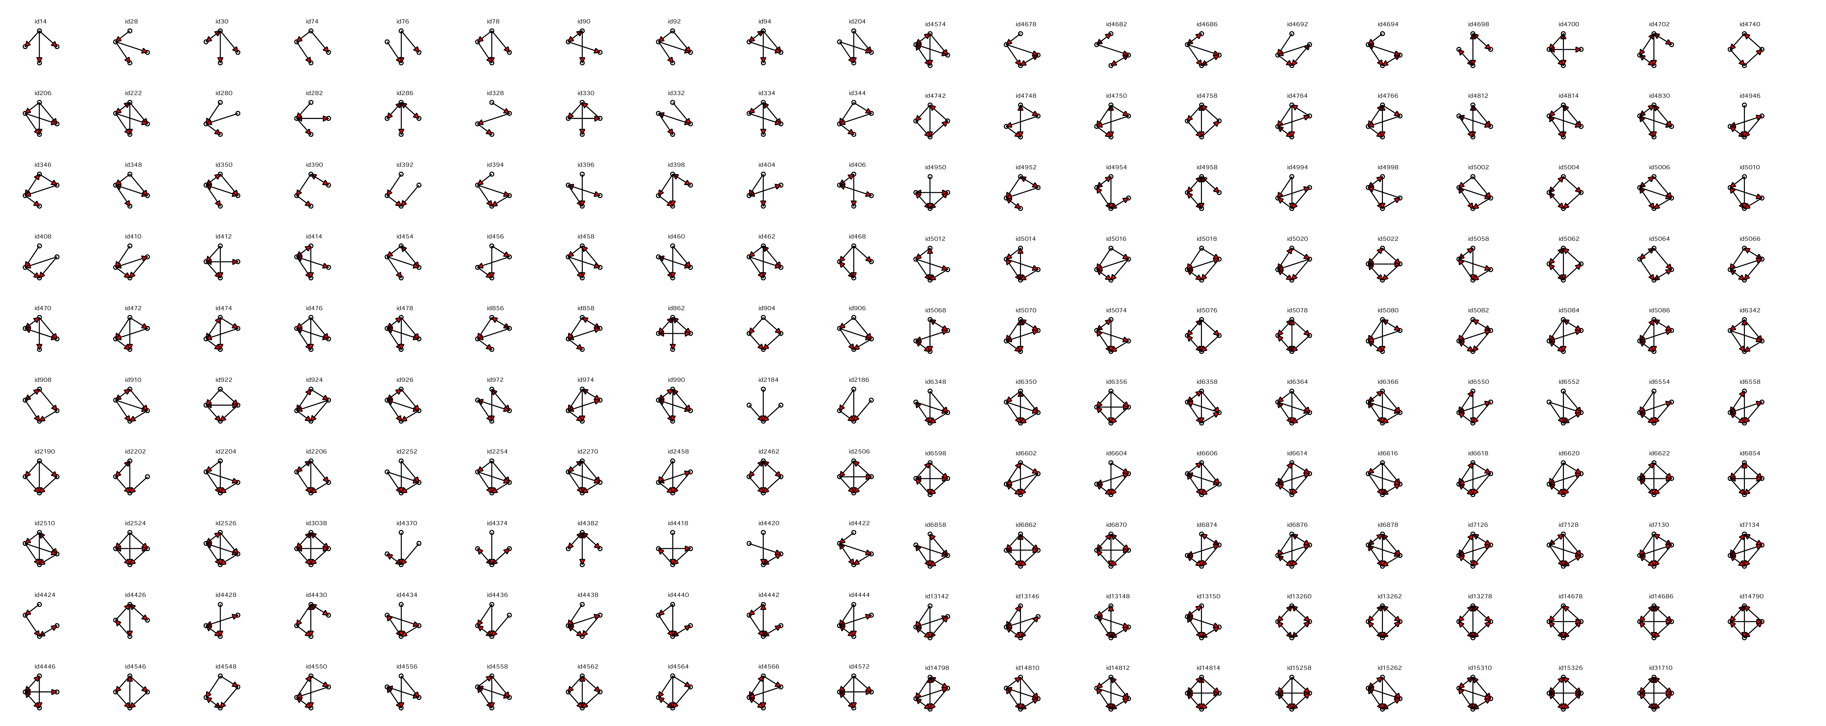
199 4-node directed connected subgraphs
And it grows fast for larger subgraphs : 9364 5-node subgraphs,
1,530,843 6-node…

Slide 37
Finding network motifs – an overview
Generation of a suitable random ensemble (reference networks)
Network motifs detection process:
Count how many times each subgraph appears
Compute statistical significance for each subgraph – probability of appearing in random as much as in real network
(P-val or Z-score)

Slide 38
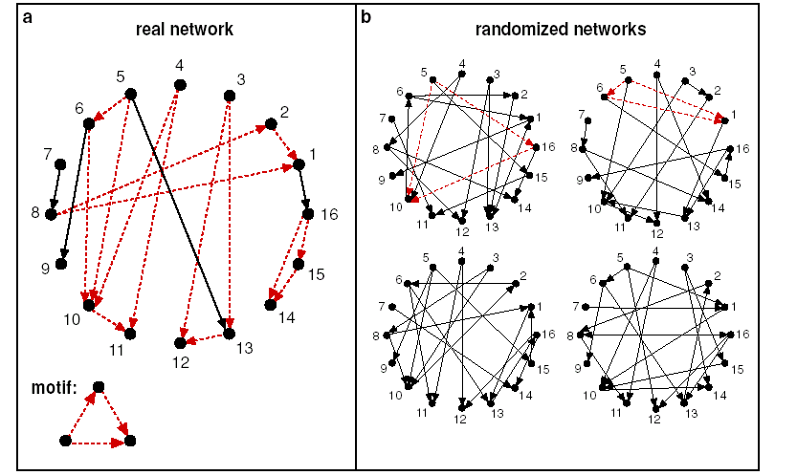
Ensemble of networks
Real = 5 Rand=0.5±0.6
Zscore (#Standard Deviations)=7.5

Slide 39
References
R. Agrawal, T. Imielinski, and A. Swami. Mining association rules between sets of items in large databases. SIGMOD, 207-216, 1993.
R. Agrawal and R. Srikant. Fast algorithms for mining association rules. VLDB, 487-499, 1994.
R. J. Bayardo. Efficiently mining long patterns from databases. SIGMOD, 85-93, 1998.

Slide 40
References:
Christian Borgelt, Efficient Implementations of Apriori and Eclat, FIMI’03
Ferenc Bodon, A fast APRIORI implementation, FIMI’03
Ferenc Bodon, A Survey on Frequent Itemset Mining, Technical Report, Budapest University of Technology and Economic, 2006

Slide 41
Important websites:
FIMI workshop
  Not only Apriori and FIM
    FP-tree, ECLAT, Closed, Maximal
  http://fimi.cs.helsinki.fi/
Christian Borgelt’s website
  http://www.borgelt.net/software.html
Ferenc Bodon’s website
  http://www.cs.bme.hu/~bodon/en/apriori/

